Slide 1
3D-IC THERMAL SURROGATE
A Physics-Informed Graph Neural Network for Chip Thermal Prediction
Si-Vision | Candidate Project Walkthrough

Slide 2
01 - THE PROBLEM
Thermal Simulation Is Accurate but Slow
1
2
3
3D-IC Design
→
3D-ICE Simulation
→
Design Iteration
.stk stack + .flp floorplans: dies, blocks, TSVs, packaging, cooling
Physics-based solver gives ground-truth per-block temperature - but is slow
Every hotspot fix or cooling change means re-running the full simulation
This project replaces the slow simulator with a trained GNN surrogate for fast design-space exploration.

Slide 3
02 - DATA & PREPROCESSING
From Simulation Files to Model-Ready Graphs
.stk / .flp files
H5 conversion + validation
Graph construction
Feature preprocessing
Raw design description
→
Contract-checked intermediate format
→
Nodes = blocks, edges = thermal links, globals = package context
→
Scaling, log1p, one-hot, engineered relative features
PREPROCESSING CHOICES THAT MATTERED
Distribution-matched split
log1p + StandardScaler
Searched 100 seeds for a train/val/test split whose 4 temperature-range distributions match - not a plain random split
Applied to every skewed, positive feature (area, power, resistance, path length...) before scaling
Scale-invariant geometry
Log-space target
Position/size features made relative to each chip's own width/height, so the model generalizes across chip sizes
log(T) is modeled and standardized, not raw Kelvin - fits the model's error behavior better across 300-500K

Slide 4
03 - MODELING
Architecture: Edge-Conditioned Message Passing + Attention
Message-Passing Block (x 4 layers)
Input Projection
→
NNConv
edge MLP generates a 64x64 weight per edge - resistance shapes the message
+ Global Context
GATv2Conv
→
Package + cooling + ambient encoded once per graph, fused before prediction
2-head attention, edge-aware, no self-loops
Merge -> activation -> residual -> LayerNorm
stabilizes 4 stacked layers
Per-node temperature
18 node / 11 edge / 21 global features . hidden = 64 . 4 layers . 2 attention heads

Slide 5
03 - MODELING
Architecture Deep Dive: Shapes and Layer Math
Input
x [N,18], edge_attr [E,11], global [1,21]
N nodes, E edges per graph
Input projection
h0 = MLP(x) -> [N,64]
Linear->64 -> LeakyReLU -> Linear->64
NNConv (per layer)
W_e = EdgeMLP(edge_attr) -> [64x64]
Edge features generate a per-edge weight matrix
GATv2Conv (per layer)
h_gat = Attn(h, edge_index, edge_attr)
2 heads, concat=False, edge_dim=11, no self-loops
Merge (per layer)
h = LayerNorm( h + LeakyReLU(Linear([h_nn;h_gat])) )
Concat 128 -> Linear 64, residual, normalize - x4
Global encoder
g = MLP(global) -> [1,64]
Same 2-layer MLP shape as input projection
Prediction head
y_hat = Linear(LeakyReLU(Linear([h_final; g])))
128 -> 64 -> 1, normalized log-temperature per node

Slide 6
03 - MODELING
Training: Physics-Informed, Range-Balanced, Overfit-Guarded
Range-Balanced Loss
Global Energy Physics Loss
300-500K split into 4 ranges, softly blended at boundaries so every regime contributes equally - not just the common mid-range
Predicted heat to ambient must match injected power per graph - a real conservation-law constraint, warmed up over 20 epochs
Log-Normal (Jensen) Correction
Diagnosed Overfitting Guard
Model predicts log(T); exp() alone is biased low - corrected per temperature range using estimated residual variance
A prior run's train/val gap grew to +21% while RMSE looked fine - added a hard gap-based stop beyond ordinary early stopping
Iteration history: range_balanced -> hard_finetuned -> hard_finetuned_x3 -> super_power -> ultra_super_power_V2000 -> playground v1-v7 (best)

Slide 7
04 - RESULTS
Full Test-Set Results
1,047 test graphs . 43,801 test nodes
5.55 K
3.78 K
-1.26 K
67.23 K
RMSE
MAE
Bias
Max Error
Error > 5K: 25.79% Error > 8K: 11.02% Error > 10K: 6.47%
Range
Nodes
RMSE
MAE
Bias
>8K
>10K
300-350 K
9,932
2.56 K
1.84 K
+0.72 K
1.28%
0.58%
350-400 K
11,468
5.08 K
3.15 K
-0.85 K
4.94%
2.35%
400-450 K
14,055
6.04 K
4.50 K
-1.43 K
15.40%
9.07%
450-500 K
8,339
7.56 K
5.75 K
-3.91 K
23.59%
14.73%
Accuracy degrades toward the hottest, highest-risk range (450-500K: RMSE 7.56K, nearly 1 in 4 nodes off by >8K) - exactly why the loss is range-balanced rather than optimized for average RMSE alone.

Slide 8
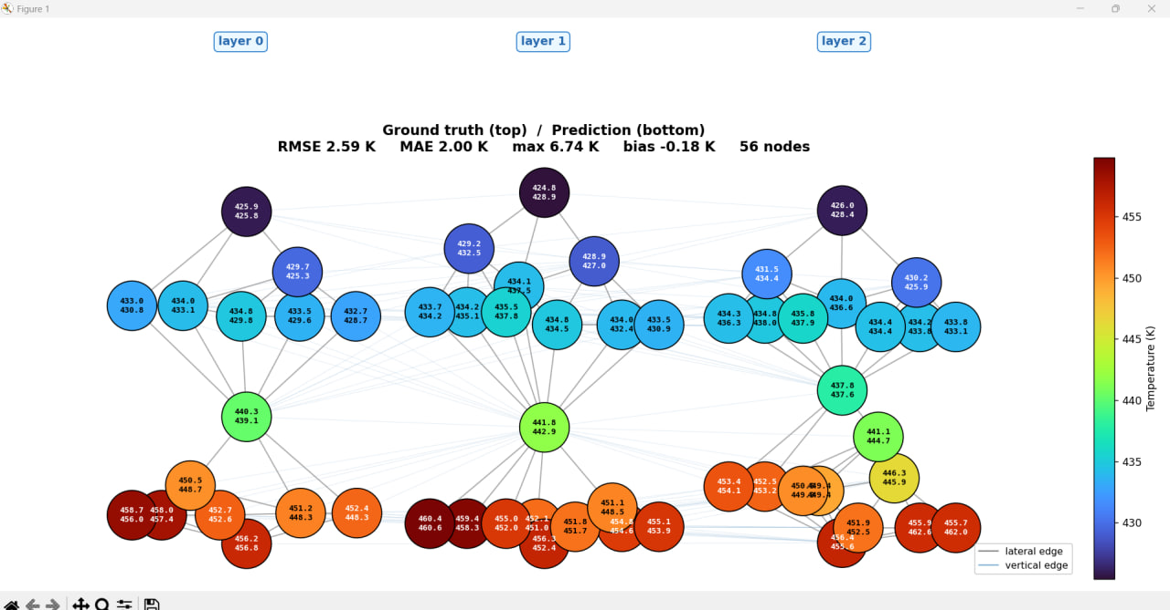
05 - THE TOOL
From Upload to Prediction, in One Request
Upload .stk / .flp (Streamlit)
↓
POST /predict (FastAPI)
↓
Build graph + preprocess
↓
Trained GNN -> per-node temps + plot
Same graph-construction contract used in training - no train/serve mismatch.
Example output: predicted vs. ground truth per block, with RMSE/MAE/bias in the title and a color-coded thermal map.
Thank you - happy to go deeper into any stage.

